Slide 1
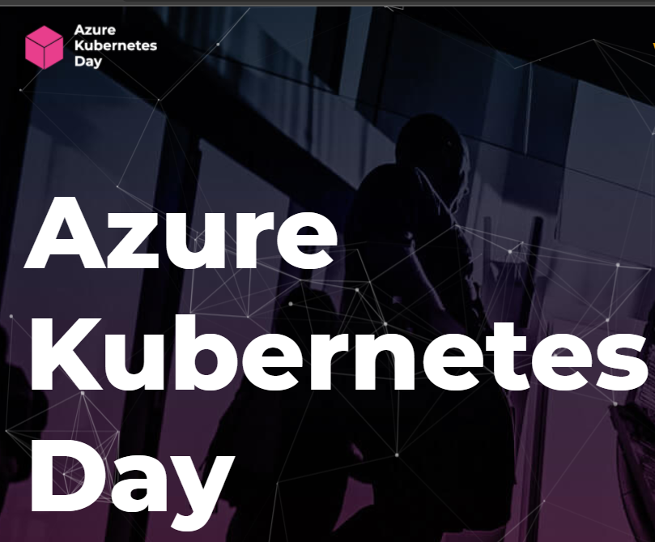
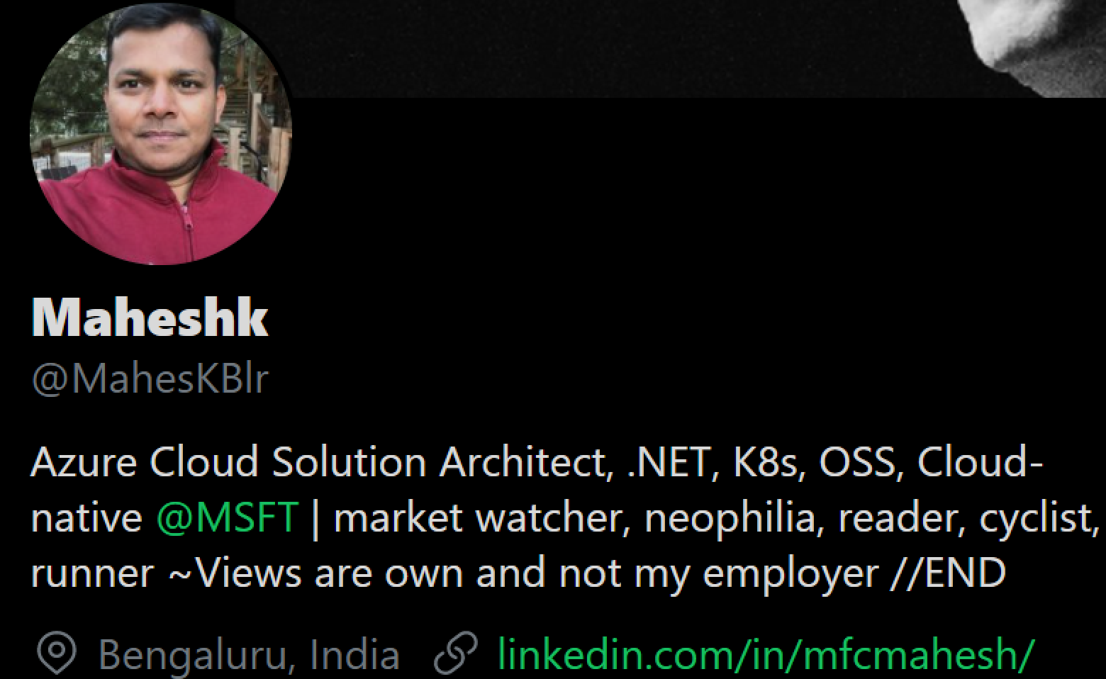
Must know Azure Kubernetes Best practices and features for better resiliency
@MaheskBlr

Slide 2
Overview
AKS specific best practices after working with multiple customers
Mostly about Day-2 challenges and solve
Upcoming features, SLA’s, Node pools, Availability Zones – for maximum resiliency
Notes:
AKS best practices for your cloud-native applications so that you can avoid blow up your workloads.
We will share some of the best practices observed and borrowed to share after working with multiple customers.
Running day-1 Ops on your k8s is somewhat easy, but it is quite daunting to manage day two challenges.
In this session, we will be learning all such practices, features so that you will have full control of your workload and achieve maximum resiliency.

Slide 3
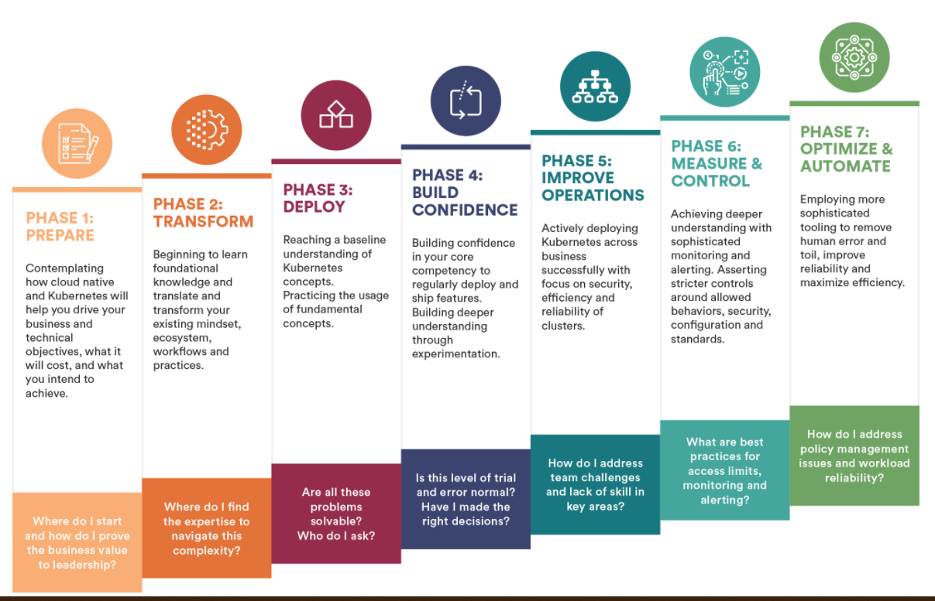
What’s Your Kubernetes Maturity?
https://www.cncf.io/blog/2021/01/12/whats-your-kubernetes-maturity/

Slide 4
1. Multi-tenancy
Namespace - logical isolation boundary
Scheduling - use resource quotas, pdb’s, advanced features like taints and tolerations, node selectors, node and pod affinity or anti-affinity
Networking - use network policies to control the flow of traffic in and out of pods
Auth and Authorization – use of RBAC and AAD, Pod Identies and Azure KeyValut
Containers – Azure Policy Add-on to enforce pod security, security contexts, scanning images.

Slide 5
2. Enforce Resource Quota
apiVersion: v1
kind: ResourceQuota
metadata:
name: dev-app-team
spec:
hard:
cpu: "10"
memory: 20Gi
pods: "10"
$ kubectl apply -f dev-app-team-quotas.yaml --namespace dev-apps
Best practice guidance - Plan and apply resource quotas at the namespace level. If pods don't define resource requests and limits, reject the deployment. Monitor resource usage and adjust quotas as needed.

Slide 6
3. Use Pod Distruption Budget (PDB’s)
apiVersion: policy/v1beta1
kind: PodDisruptionBudget
metadata:
name: nginx-pdb
spec:
minAvailable: 3
selector:
matchLabels:
app: nginx-frontend
$ kubectl apply -f nginx-pdb.yaml
Best practice guidance - To maintain the availability of applications, define Pod Disruption Budgets (PDBs) to make sure that a minimum number of pods are available in the cluster.

Slide 7
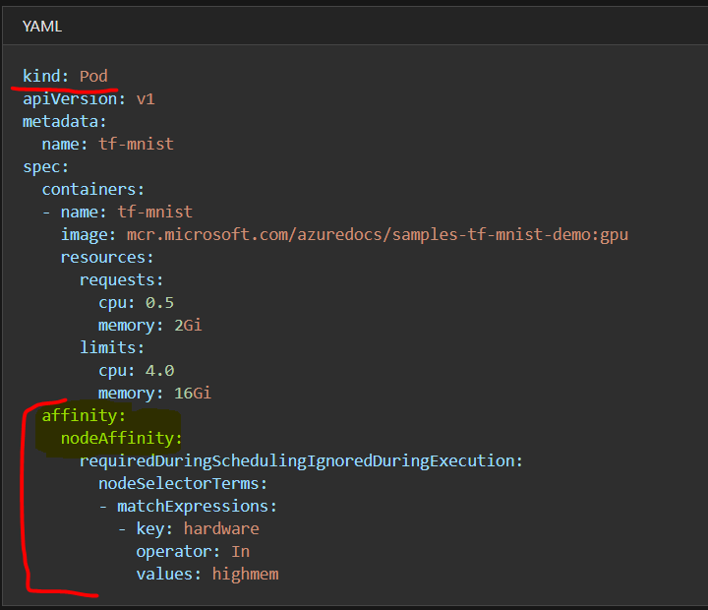
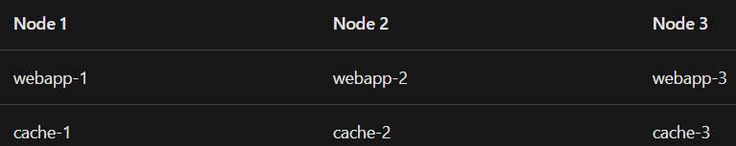
Best practice guidance: Control the scheduling of pods on nodes using node selectors, node affinity, or inter-pod affinity. These settings allow the Kubernetes scheduler to logically isolate workloads, such as by hardware in the node.
4. Use Node Affinity, Inter-pod affinity and Anti-affinity

Slide 8
5. Use Kube-Advisor
Scans a cluster and reports on issues that it finds
Say, identify pods that don't have resource requests and limits in place
Best practice guidance
Regularly run the latest version of kube-advisor open source tool to detect issues in your cluster. If you apply resource quotas on an existing AKS cluster, run kube-advisor first to find pods that don't have resource requests and limits defined.

Slide 9
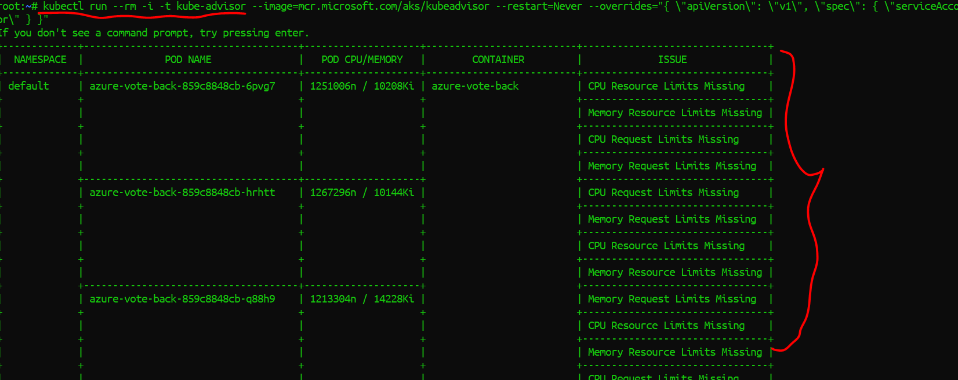
https://github.com/Azure/kube-advisor

Slide 10
6. AKS - Uptime SLA
Uptime SLA is an optional feature to enable a financially backed, higher SLA for a cluster.
99.95% of K8s API server endpoint for clusters that -> AZ
99.9% of availability for clusters that don't use AZ.
AKS uses master node replicas across update and fault domains to ensure SLA requirements are met.

Slide 11
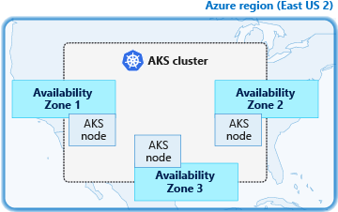
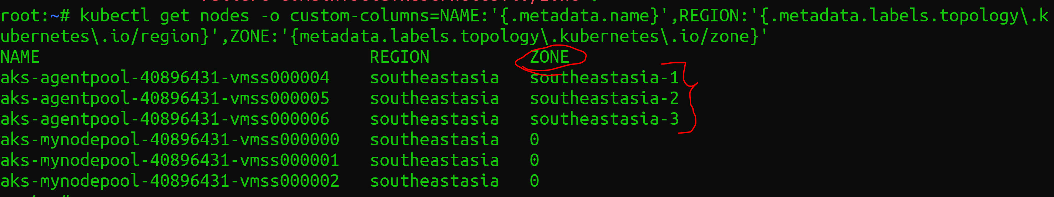
7. Create an AKS cluster across availability zones
az group create --name myResourceGroup --location eastus2
az aks create \
--resource-group myResourceGroup \
--name myAKSCluster \
--generate-ssh-keys \
--vm-set-type VirtualMachineScaleSets \
--load-balancer-sku standard \
--node-count 3 \
--zones 1 2 3

Slide 12
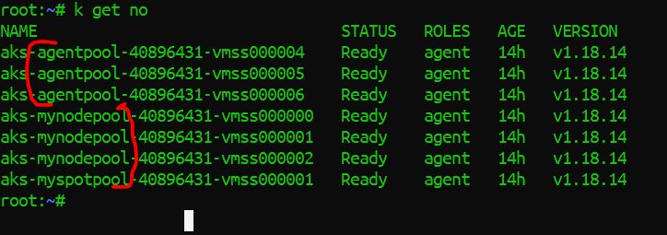
8. Have more than 1 Node Pool
az aks nodepool add \
--resource-group aksdayconf-rg \
--cluster-name OpsTeamAKScluster \
--name mynodepool \
--node-count 3
az aks nodepool list --resource-group aksdayconf-rg --cluster-name OpsTeamAKScluster

Slide 13
9. Azure Policy
Continues compliance is must to maintain compliance in a proactive rather reactive approach.
Achieve real-time cloud compliance at scale with consistent resource governance. It has a quite an exhaustive list of policies here
https://github.com/azure/azure-policy
Best part is, we could roll out custom policies on the resources. The rules can be written in a declarative style.
Notes:
Continuous compliance is not a new thing but has been getting lot of traction with customers. Naively put,

Slide 14
10. Auto Scale Cluster nodes and pods
As demand for resources change, the number of cluster nodes or pods that run your services can automatically scale up or down.
Use both HPA & Cluster Autoscaler approach.
This approach to scaling lets the AKS cluster automatically adjust to demands and only run the resources needed.
az aks nodepool add \
--resource-group aksdayconf-rg \
--cluster-name OpsTeamAKScluster \
--name mynodepool \
--enable-cluster-autoscaler \
--min-count 5 \
--max-count 10 \
--no-wait

Slide 15
11. Start and Stop AKS Cluster
az extension add --name aks-preview
2) az extension update --name aks-preview
3) az feature register --namespace "Microsoft.ContainerService" --name "StartStopPreview“
4) az feature list -o table --query "[?contains(name, 'Microsoft.ContainerService/StartStopPreview')].{Name:name,State:properties.state}“
5) az provider register --namespace Microsoft.ContainerService
6) az aks stop --name OpsTeamAKScluster --resource-group aksdayconf-rg
7) az aks start --name OpsTeamAKScluster --resource-group aksdayconf-rg
https://docs.microsoft.com/en-us/azure/aks/start-stop-cluster
* Preserve for 12 months, supports only VMSS

Slide 16
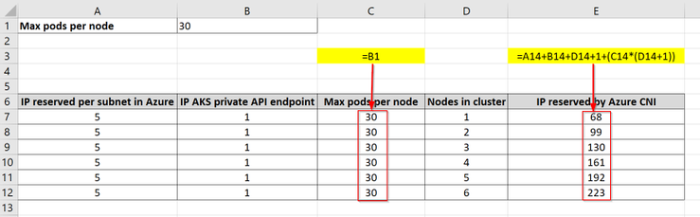
12. AKS Cluster Capacity Planning
How many nodes do I need in my AKS cluster?
Does the size of the subnet of my nodes matter?
How many pods could be run on the cluster?
https://techcommunity.microsoft.com/t5/core-infrastructure-and-security/azure-kubernetes-service-cluster-capacity-planning/ba-p/1474990

Slide 17
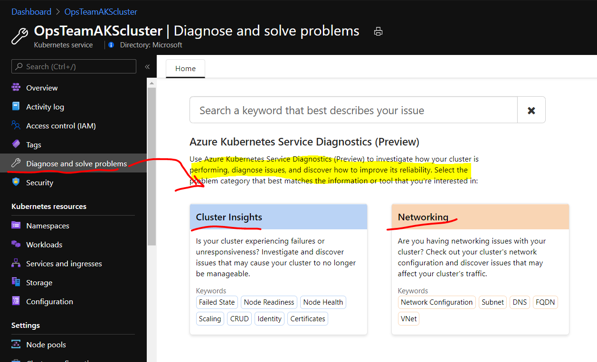
13. Use AKS Diagnostics

Slide 18
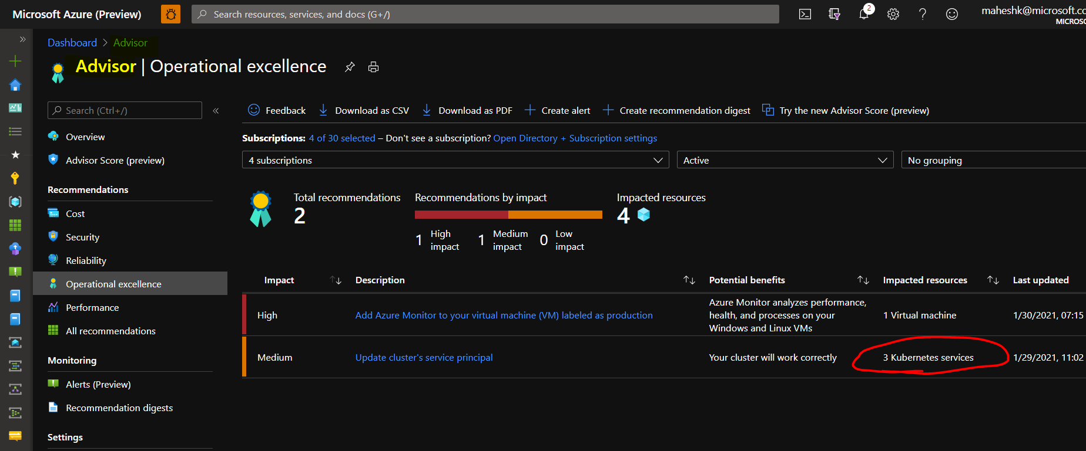
14. Use Azure Advisor

Slide 19
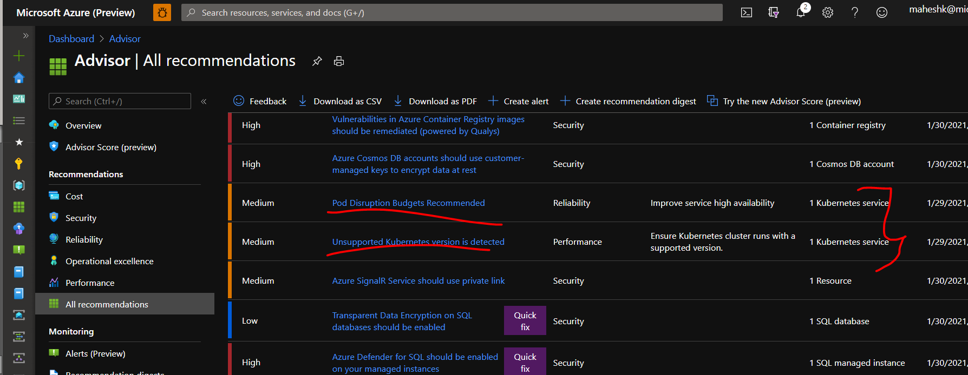
14.1 Use Azure Advisor

Slide 20
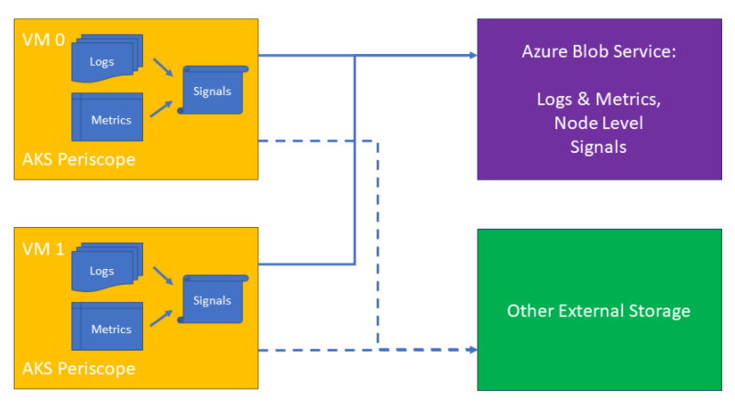
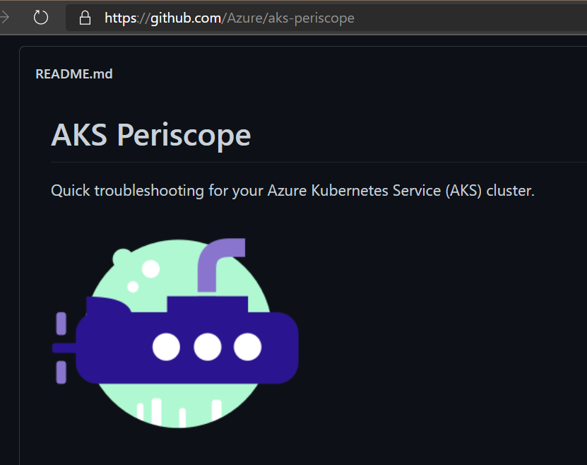
15. Use Azure Periscope
when things do go wrong, AKS customers need a tool to help them diagnose and collect the logs necessary to troubleshoot the issue.
https://github.com/Azure/aks-periscope

Slide 21
16. Production Checklist
Regions - Select the region based on your compliance requirement – You cannot change later
Version – Select the most stable version for production
Use Node Pools and Az Zones – minimum of 2 pods and use AZ
4. Services - recommend using Ingress rather than exposing all of them as Load Balancer
5. VM Type – Select appropriate VM type – you can only add new node pools but cannot change types
6. Max Pods in Cluster, Max Pods in Node, Pod request (CPU/Memory), Pod limits (CPU/Memory)
7. Networking : Recommend Azure CNI instead Kubenet (Unless org has a restriction on IP Addr to be assigned to the subnet)
8. API Server Access – restrict via IP Whitelisting; Storage and Databases – use managed/PaaS as much as possible
9. Monitor – Use Prometheus, Filebeat or Azure Monitor (easy to implement)
10. Node restarts – recommend Kured for automating node reboots after OS Patching

Slide 22
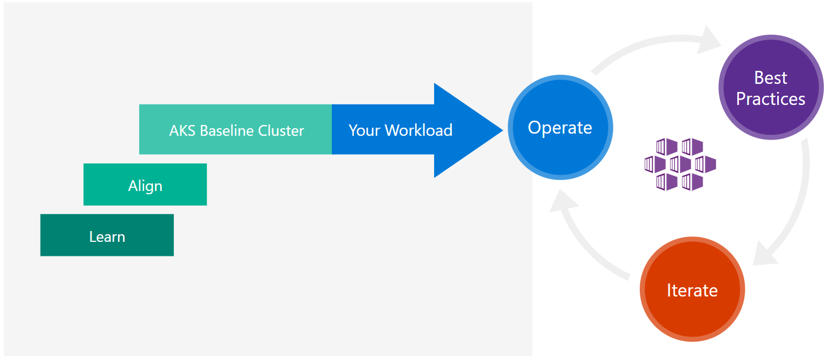
Azure Kubernetes Service solution journey
Notes:
Kubernetes is an open-source system for automating deployment, scaling, and management of containerized applications. Azure Kubernetes Service (AKS) makes it simple to deploy a managed Kubernetes cluster in Azure.
Organizations are at various points in their understanding, rationalizing, and adoption of Kubernetes on Azure. Your organization's journey will likely follow a similar path to many other technologies you've adopted; learning, aligning your organization around roles & responsibilities, and deploying production-ready workloads. From there, you'll iterate; growing your product as your customer and business demands change.
As part of on going operations, you may wish to spot check your cluster against current recommended best practices. The best place to start is to ensure your cluster is aligned with Microsoft's AKS Baseline Cluster.

Slide 23

AKS DevOps must links
- AKS Current preview features: https://aka.ms/aks/preview-features
- AKS Release notes: https://aka.ms/aks/releasenotes
- AKS Public roadmap: http://aka.ms/aks/roadmap
- AKS Known-issues: https://aka.ms/aks/knownissues
- AKS Feature Requests: https://aka.ms/aks/feature-requests
- AKS Public FAQ: https://aka.ms/aks/public-faq
Q&A - Thank you
https://www.the-aks-checklist.com/
MahesKBlr
https://www.linkedin.com/in/mfcmahesh/ Maheshk@microsoft.com

Slide 24
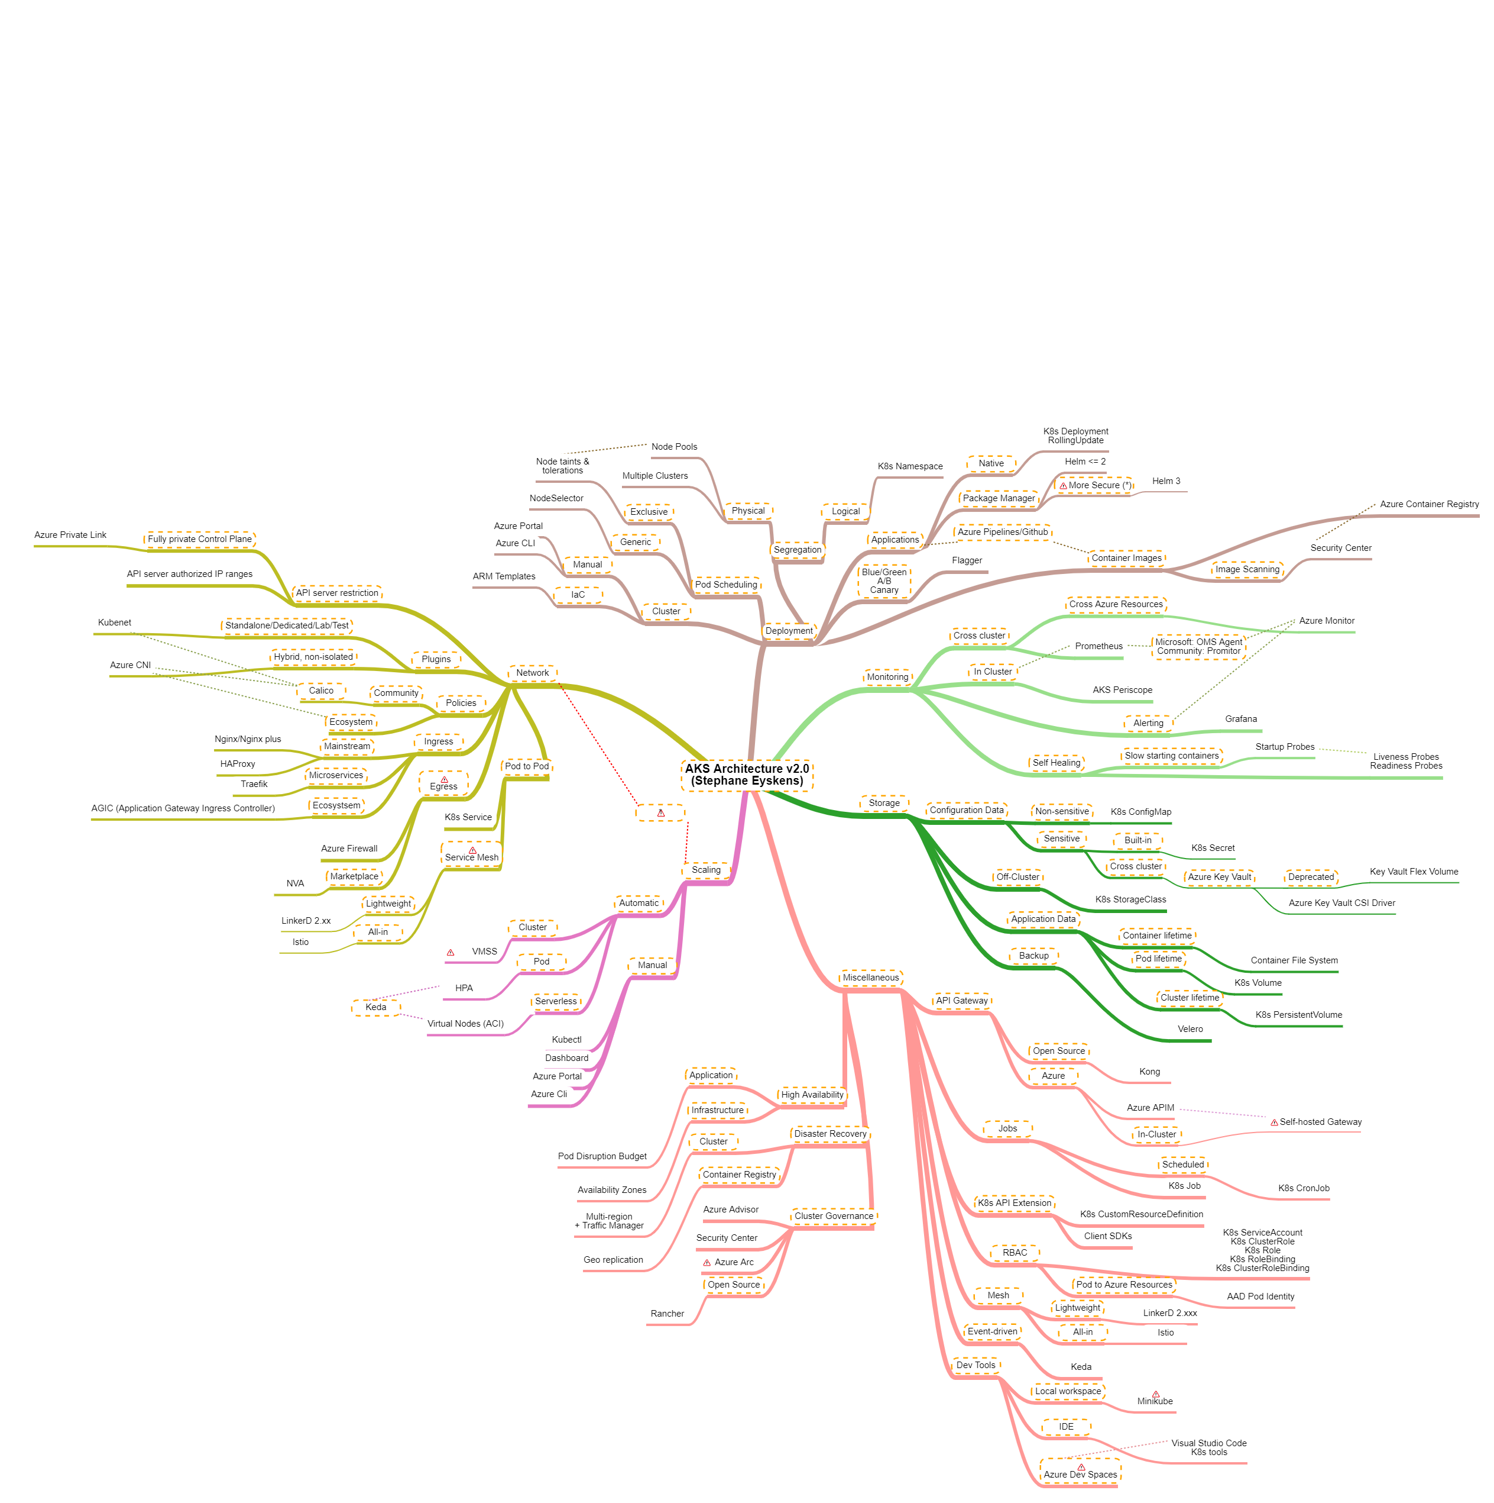

Slide 25
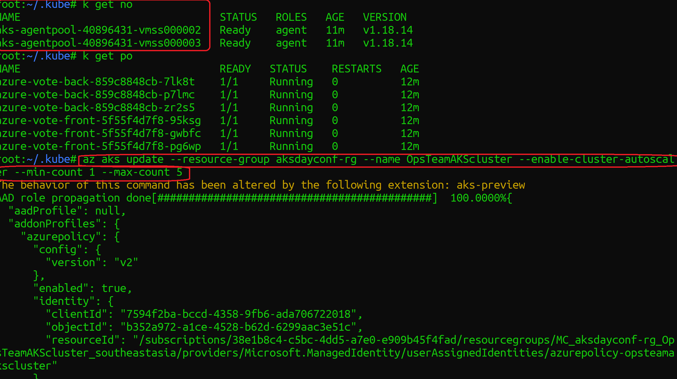

Slide 26
Increase your application availability with pod anti-affinity settings in Azure Kubernetes Service
https://www.danielstechblog.io/increase-your-application-availability-with-pod-anti-affinity-settings-in-azure-kubernetes-service/
VERTICAL POD AUTOSCALING: THE DEFINITIVE GUIDE
https://povilasv.me/vertical-pod-autoscaling-the-definitive-guide/
Kubernetes Networking
https://dominik-tornow.medium.com/kubernetes-networking-22ea81af44d0
A Guide to the Kubernetes Networking Model
https://sookocheff.com/post/kubernetes/understanding-kubernetes-networking-model/

Slide 27
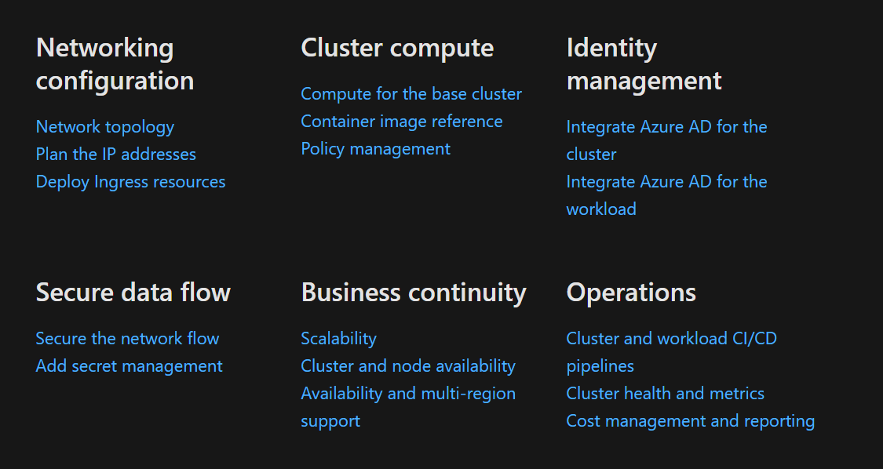
we’ll build a baseline infrastructure that deploys an Azure Kubernetes Service (AKS) cluster. This article includes recommendations for networking, security, identity, management, and monitoring of the cluster based on an organization’s business requirements.
https://github.com/mspnp/aks-secure-baseline
Notes:
Microsoft's AKS Baseline Cluster is the starting point to help you build production-ready AKS clusters. We recommend you start from this baseline implementation and modify it to align to your workload's specific needs and Well-Architected Framework priorities.
Microsoft's AKS Baseline Cluster

